Slide 1

Data Collection, Cleaning & EDA project on Home Accommodation Analysis
Team Members
Golla Ravi Teja
G. Rakesh

Slide 2
About us
Background : B.Tech
Team Members: Golla Ravi Teja (Civil Engg) and G.Rakesh (Mech Engg)
Why you want to learn Data Science:
We feel that Data Science is one of the booming technology in present scenario, so coming from non-tech background we personally feel that it’s the right platform to make a big stage for our career.
Any work experience:- No

Slide 3
Agenda
Objective of the Project
Data Collection
Raw Data
Data Cleaning
Data Visualization
Uni-variant Analysis
Bi-variant Analysis
Conclusion

Slide 4
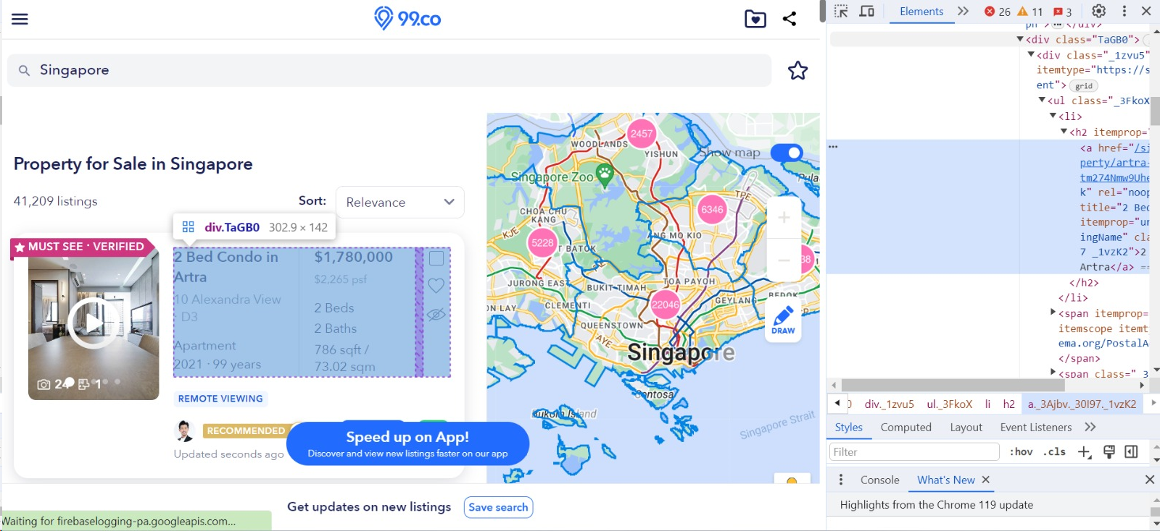
OBJECTIVE:- The main aim is to find the best house with all facilities at minimum price in Singapore. URL = https://www.99.co/singapore/sale

Slide 5
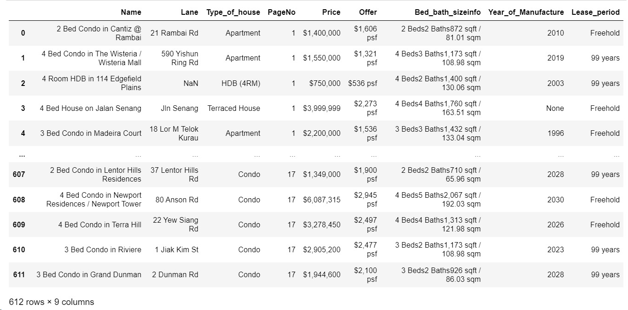
Raw Data

Slide 6
Data Collection
For real time analysis data is scrapped from https://www.99.co/singapore/sale website
The collected Website used to buy ,rent and sale properties for commercial and residential purpose
Save it to the .csv file
Extract the data using inspect for all parameters in object class
Create DataFrame using the classes
Scrap the data using Beautiful Soup library

Slide 7
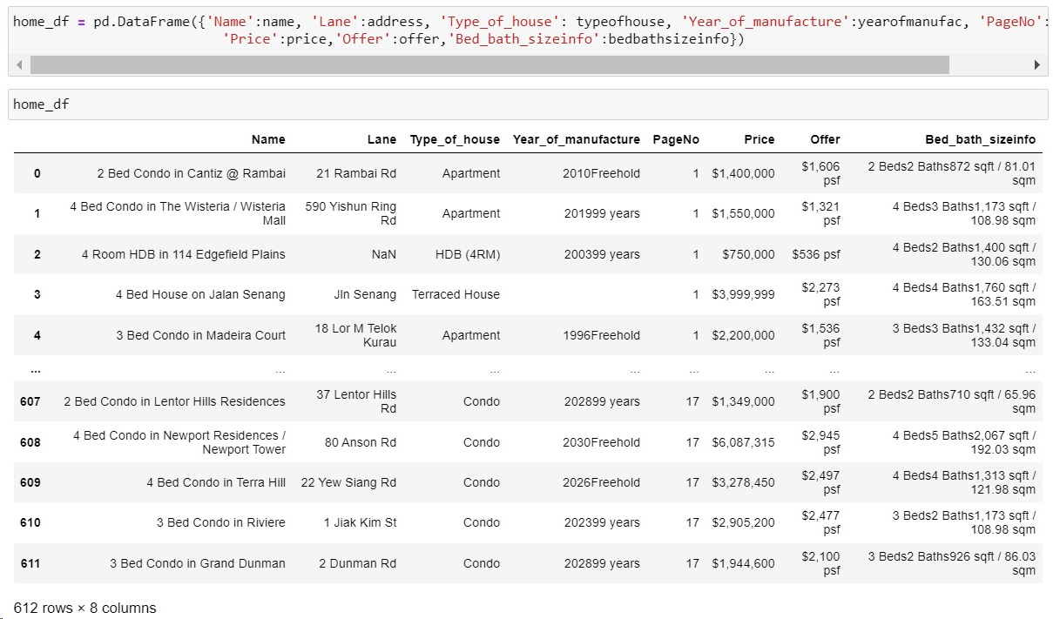
Data Cleaning
It’s a process were
special characters,
white spaces and
unwanted data is
removed using regex,
Conditional statements
and loops to create
individual columns
based on column names.

Slide 8
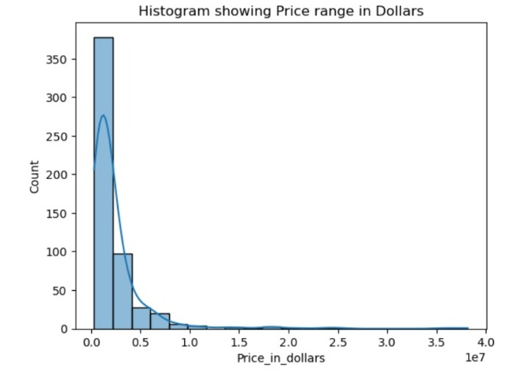
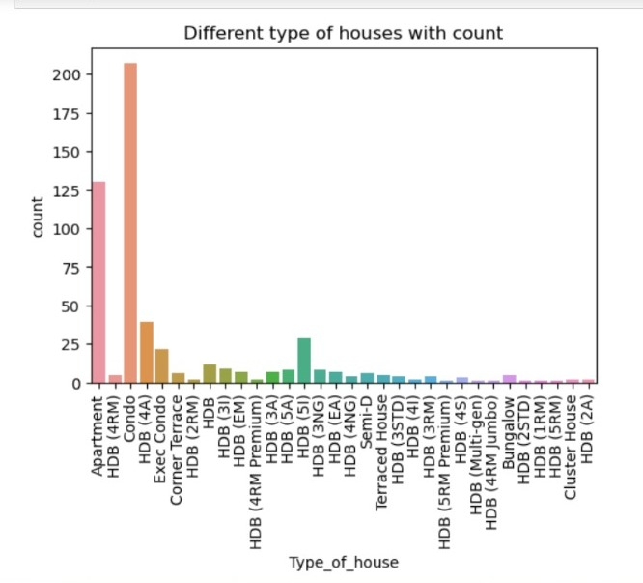
Data Visualization
From the above Countplot, maximum number of sales are happening for condo type of house followed by Apartments and HDB(4A).
Histogram shows that the most number of sales for different houses, price is ranging from 1000000-2000000 in dollars.

Slide 9
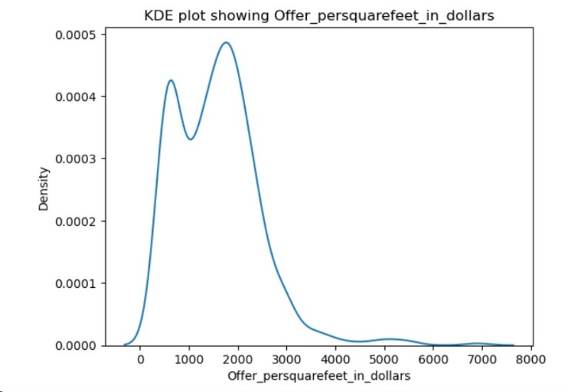
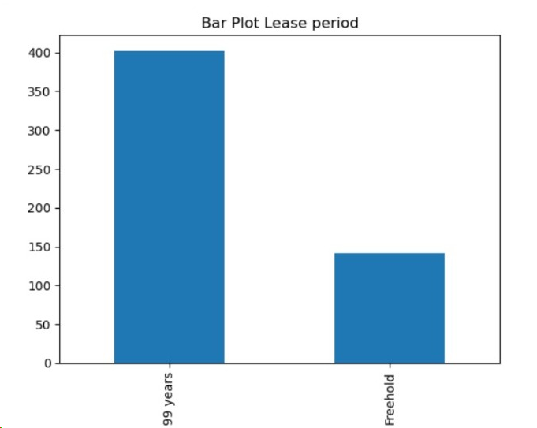
Analysis on LeasePeriod and offer_price_in_dollar
From the first graph Boxplot we can conclude that for nearly 400 houses the lease period time is 99years and nearly 140 houses are Freehold.
From the third graph we conclude that for most number of houses the offer per sqft is range in between 1000- 2800 dollars.

Slide 10
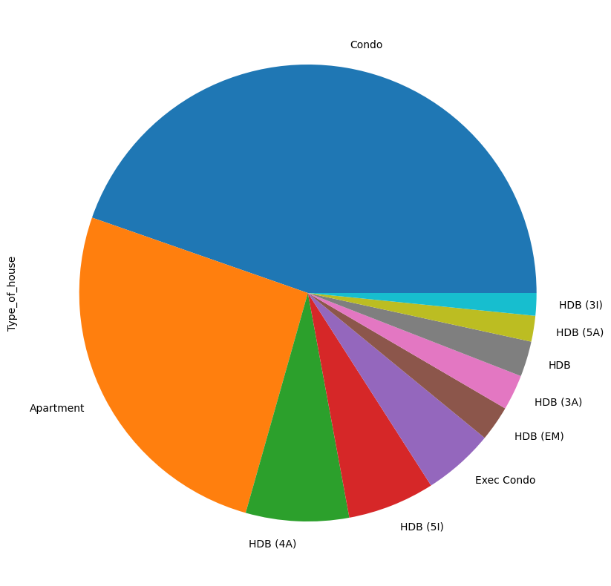
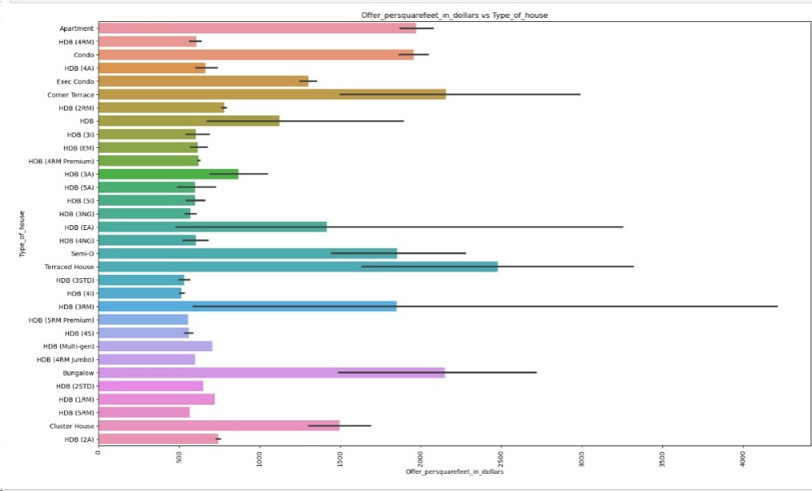
Analysis on Type_of_house and offer_persquarefeet_in_dollars
Analysis on Type_of_house:-
Condo is a type of house is which has more percentage of sales.
First graph signifies that the maximum offer per sqft is 2500 for Terraced House, followed by Corner Terraced, Bungalow, Apartment and Condo are nearly 2500, 2400, 2350 and 2300 respectively.

Slide 11
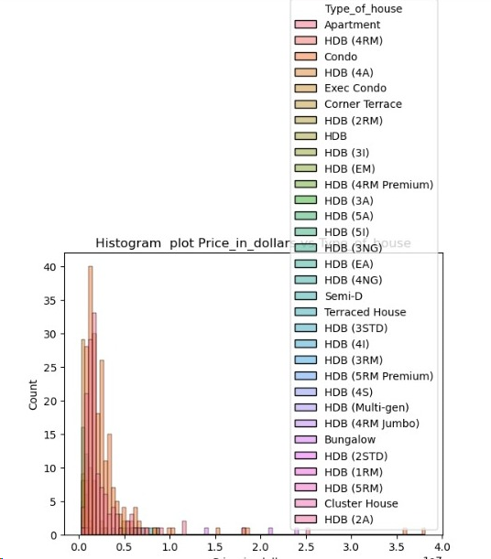
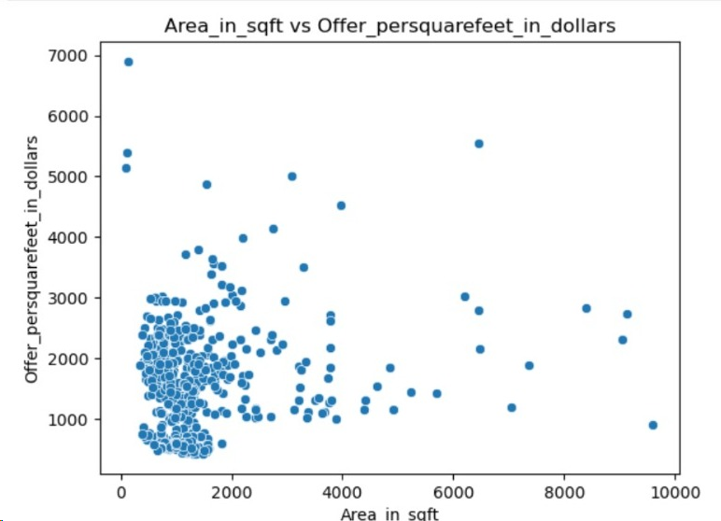
First graph Histogram represents that the condo house is the most expensive house with 40 houses.
Second graph Scatterplot indicates that the most of the data lies between 500-3000.

Slide 12
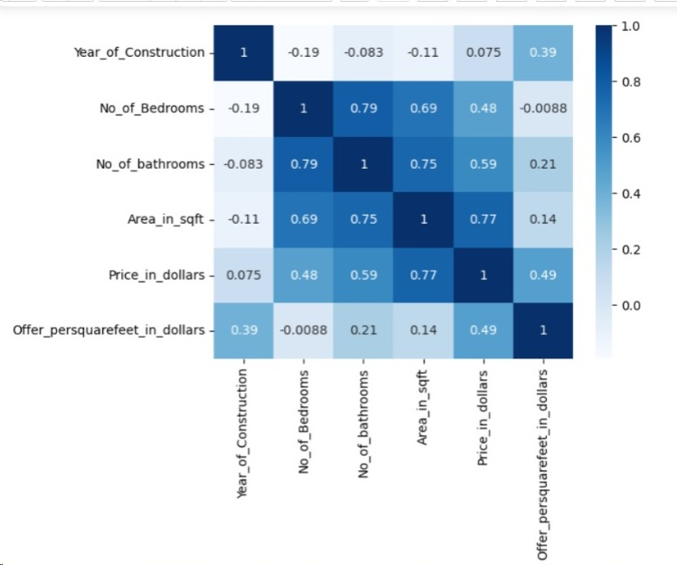
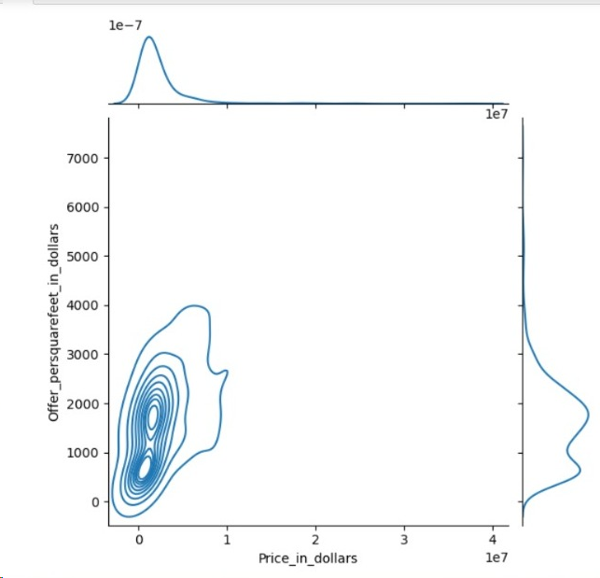
The below Rugplot shows that analysis of Price_in_dollars and Offer_persquarefeet_in_dollars.The closer waves contains more data and wider waves contains less data.
By using heatmap we can find the correlation between the coloumnsHeatmaps are effective for identifying patterns, trends, and correlations in the data.

Slide 13
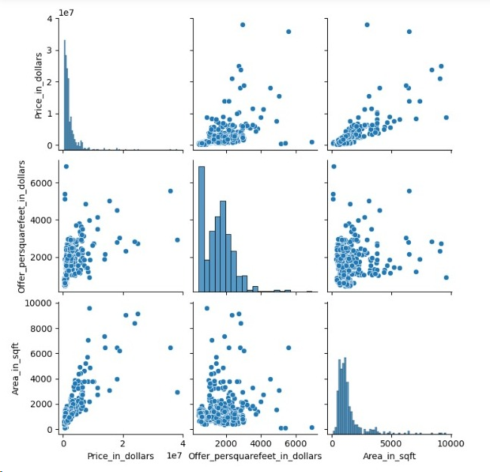
Its shows pairwise relationship in a dataset

Slide 14
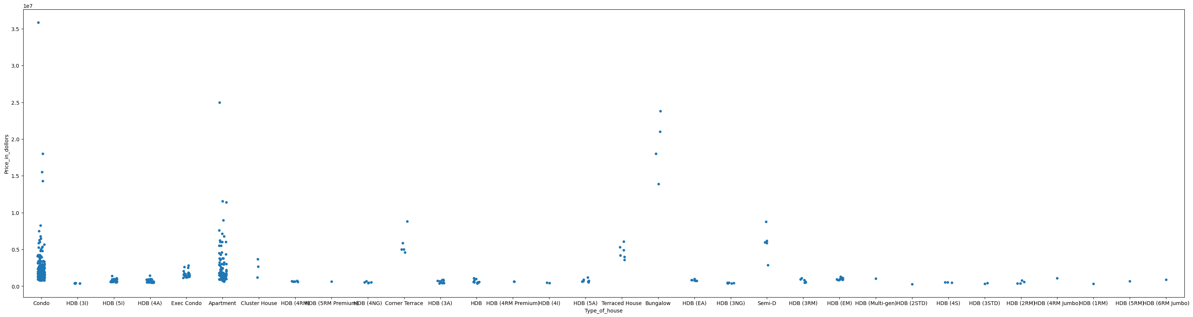
The above scatterplot shows that the analysis between the type of house and price in dollar as result is condo is having the more dots in group structure at the bottom of it compare with the other type of house condo having more group.so,condo having the less price followed by apartment.

Slide 15
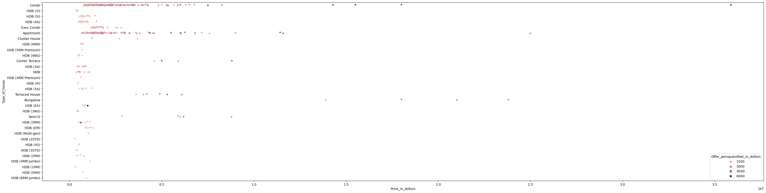
The above scatterplot is the analysis on combination of offer price per sqft and price in dollar and type of house, this graph indicates that more dark color circles represents that more offer per sqft.so conclude that condo is the best choice to buy, who is looking for more offer per sqft.

Slide 16
Conclusion
By analyzing user interactions and feedback, it's evident that certain aspects of the website contribute to a positive user experience, while others may lead to dissatisfaction.
Maximum number of customers has 2 choices of Type of Accommodation as Condo and Apartments.
The customer always look for more offer with minimum(affordable)price of Accommodation.

Slide 17

THANK YOU

